Slide 1

Assignment-1
Use VirtualBox to Create Multiple VMs, Connect These VMs, and Host One Microservice-Based Application.
-- Prof. Sumit Kalra

Slide 2
Index
Objective
Installation of VirtualBox
2.1 Various Steps Involved During Installation
Downloading Ubuntu 24.04.1 LTS File For Installation
4. Creation of Virtual Machine-1 – 1/4
4.1 Configuring Virtual Machine – 2/4
4.2 Configuring Virtual Machine – 3/4
4.3 Configuring Virtual Machine – 4/4
4.4 Configuring Virtual Machine – VM2 and VM3
5. Starting Deployment of Virtual Machines with Ubuntu OS
6. Internal connectivity of VMs through static IPv4
6.1 Ping Results – VM1(Self) → VM2 and VM3
6.2 Pin Results – VM2(Self) → VM1 and VM3
6.3 Ping Results – VM3(Self) → VM1 and VM3
7. Flask-Based Microservice Deployment Across Three VMs
7.1 Architecture Diagram of Microservice on 3 VMs
7.2 API Gateway (VM-1 - 10.0.2.4)
7.3 API Gateway (VM-1 - 10.0.2.4) – Cont.
7.4 Worker Node 1 (VM-2 - 10.0.2.5)
7.5 Worker Node 2 (VM-3 - 10.0.2.15)
8. How They Work Together
9. Step-by-Step Implementation – 1/6
9.1 Step-by-Step Implementation – 2/6
9.2 Step-by-Step Implementation – 3/6
9.3 Step-by-Step Implementation – 4/6
9.4 Step-by-Step Implementation – 5/6
9.5 Step-by-Step Implementation – 6/6
Configuration of network settings to connect the VMs.
Configuring the internal connectivity of all three VMs through static IPv4.
Testing the connectivity of multiple VMs by Ping Test.
Testing the connectivity and functionality of three VMs using Flask-based microservice.
Conclusion of Microservice testing.
Completed By: Nitin Awasthi
Roll No: G24AI1009
Contact: +91-9599089475

Slide 3
1. Objective
Create and configure multiple Virtual Machines (VMs) using VirtualBox,
Establish a network between them.
Deploy a microservice-based application across the connected VMs.

Slide 4
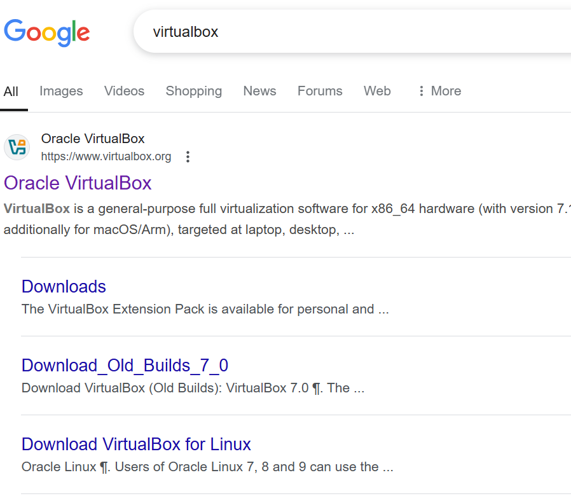
2. Installation of VirtualBox
Visit the official website: https://www.virtualbox.org/
Click on the "Downloads" section.
Choose the appropriate version for your operating system (Windows, macOS, or Linux).
Run the downloaded installer file (.exe for Windows, .dmg for macOS, .deb or .rpm for Linux)
Follow the on-screen instructions in the setup wizard.
Accept the default settings unless you need custom configurations.
Various steps involved in the installation are shown in the next slide.

Slide 5
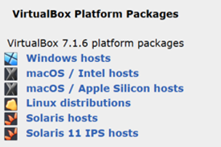
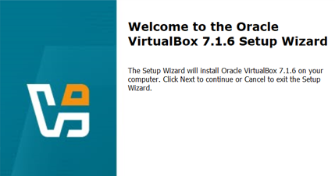
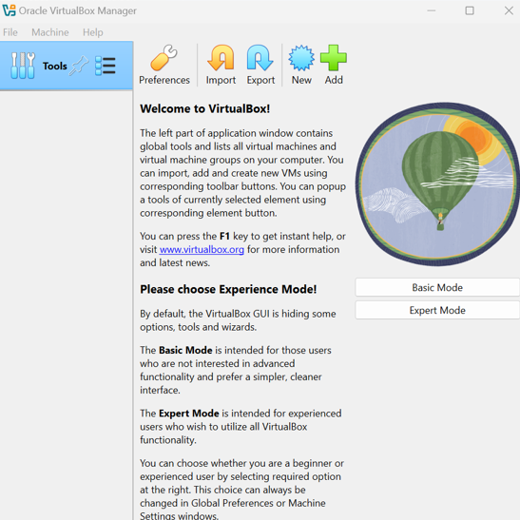
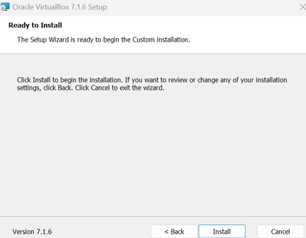
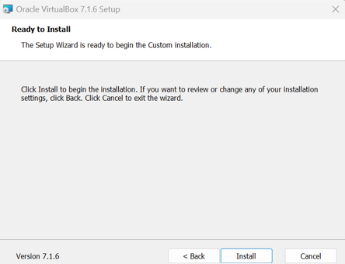
2.1 Various Steps Involved During Installation

Slide 6
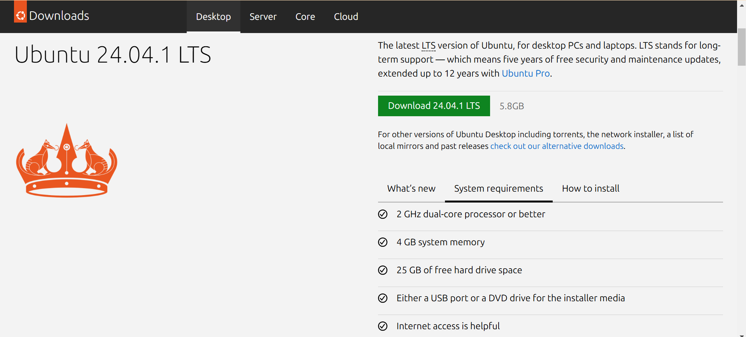
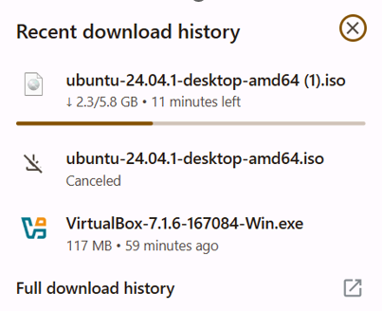
3.Downloading Ubuntu 24.04.1 LTS File For Installation
The Ubuntu 24.04.1 LTS ISO file is needed to install and boot the OS inside the VM.

Slide 7
4. Creation of Virtual Machine-1 – 1/4
This page is the welcome screen of Oracle VirtualBox Manager, which provides an introduction and guidance for first-time users. It includes the following key elements:
Introduction to VirtualBox
Explains that VirtualBox is a tool for managing virtual machines.
Mentions that users can import, add, and create new VMs using toolbar buttons.
Experience Mode Selection
Offers two modes for users:
Basic Mode: A simplified interface with fewer options.
Expert Mode: A more advanced interface with full functionality.
Toolbar Options
Provides options like Preferences, Import, Export, New, and Add for VM management.

Slide 8
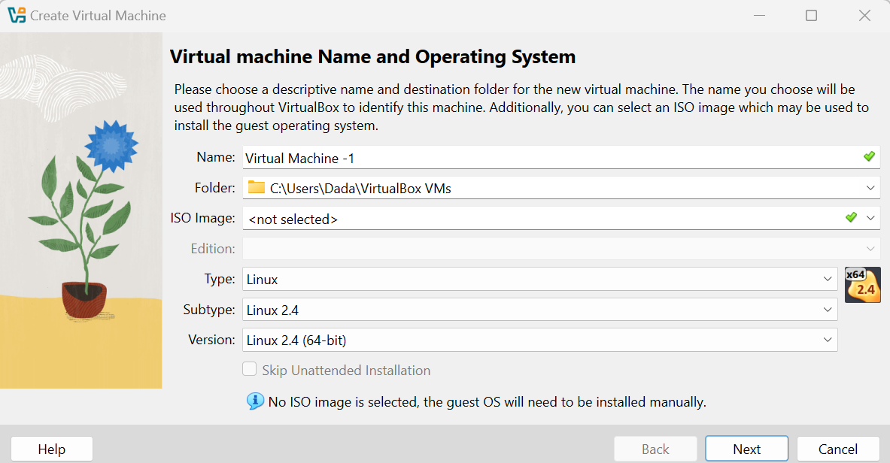
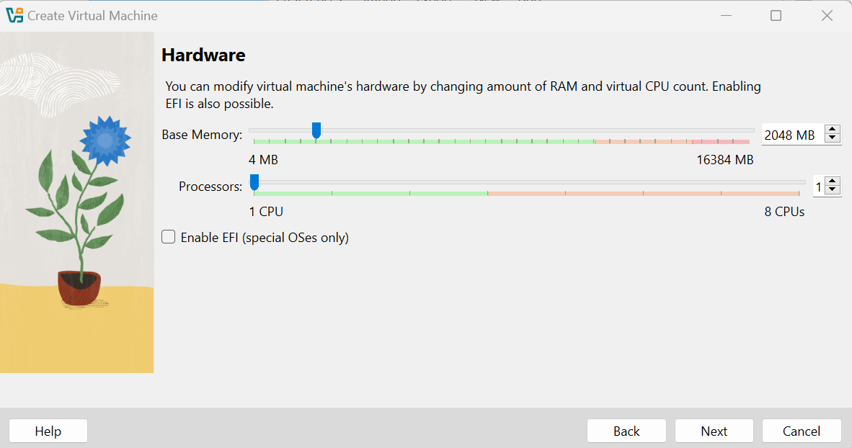
4.1 Configuring Virtual Machine – 2/4
Steps to Create a Virtual Machine in VirtualBox (Based on Image)
Enter VM Name – Provide a name (e.g., “Virtual Machine-1").
Select default or dedicated folder as save location.
Choose an ISO image of Ubuntu 24.04.1 LTS
Select OS Type – Choose Linux as the Type.
Choose OS Version – Select Ubuntu 64-bit (or the appropriate Linux version).
Click "Next" – Proceed to the next configuration step.
Select Base Memory “4096 MB” for Ubuntu OS.
Consider Default Processor settings in my case.

Slide 9
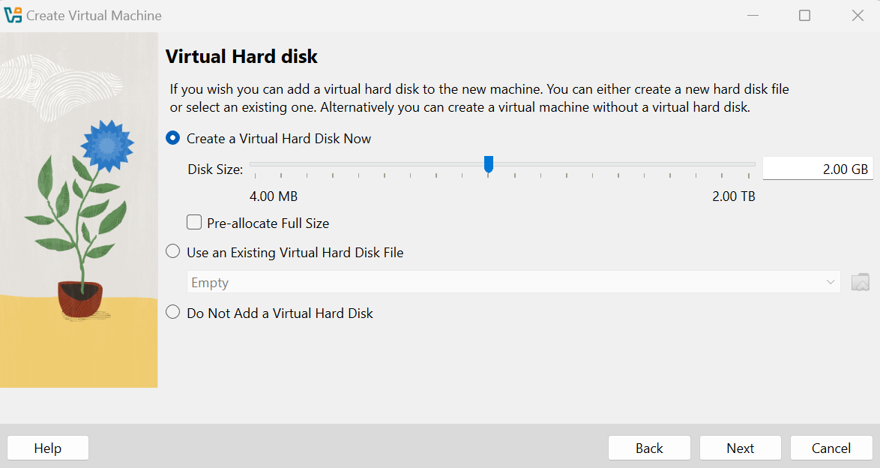
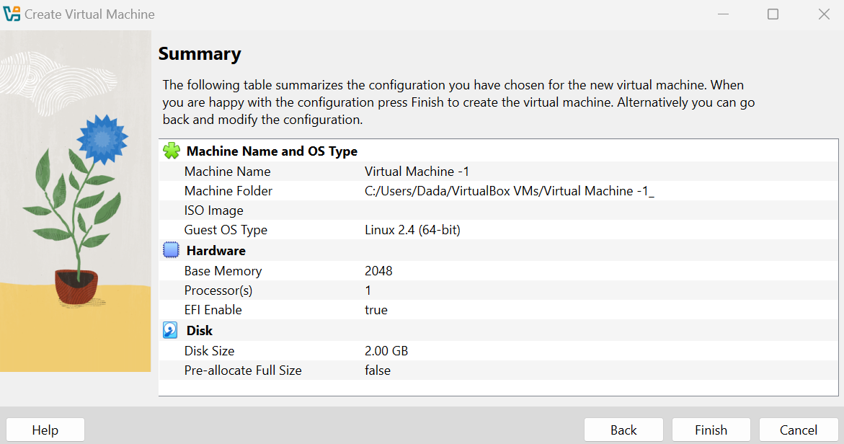
4.2 Configuring Virtual Machine – 3/4
Select "Create a Virtual Hard Disk Now" – This will create a new virtual disk for the VM.
Set Disk Size – Adjust the disk size (e.g., 25GB recommended, but at least 2GB as shown in the image).
Choose Pre-allocation (Optional) – Tick "Pre-allocate Full Size" for better performance or leave it unchecked for dynamic allocation.
Click "Next" – Confirm the disk settings and proceed.
Complete VM Creation – Click "Finish" to finalize the Virtual Machine setup

Slide 10
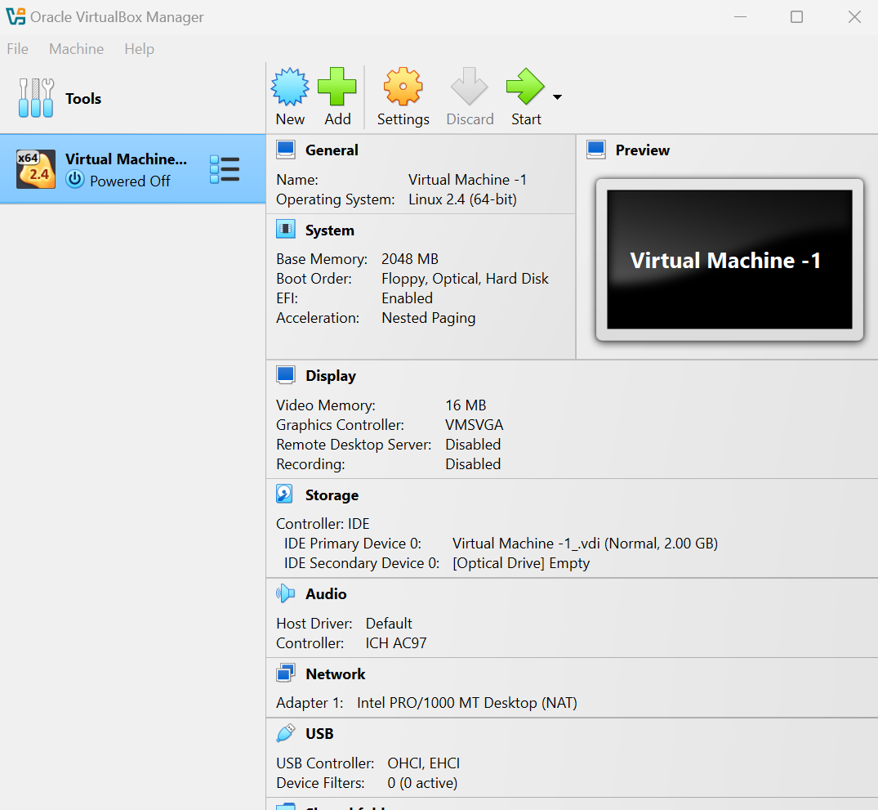
4.3 Configuring Virtual Machine 4/4
This page is the VirtualBox Manager interface, showing the details of a created but currently powered-off virtual machine (Virtual Machine -1). It provides an overview of the VM's configuration, including:
VM Name: Virtual Machine -1
OS Type: Linux 2.4 (64-bit)
Memory Allocation: 2048 MB (2GB) RAM
Boot Order: Floppy, Optical, Hard Disk
Storage: 2GB Virtual Disk (VDI) with an empty optical drive
Display: 16MB Video Memory, VMSVGA Graphics Controller
Network: Intel PRO/1000 MT Desktop (NAT mode)
Audio: ICH AC97 Controller (Default)
USB Support: OHCI, EHCI (0 active filters)
Available Actions: New, Add, Settings, Discard, Start

Slide 11
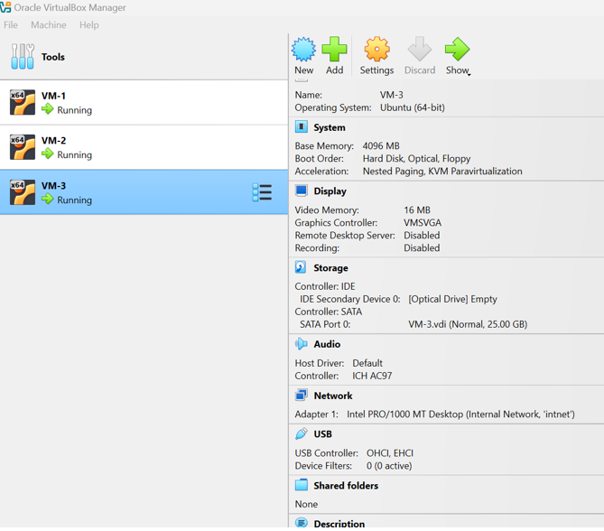
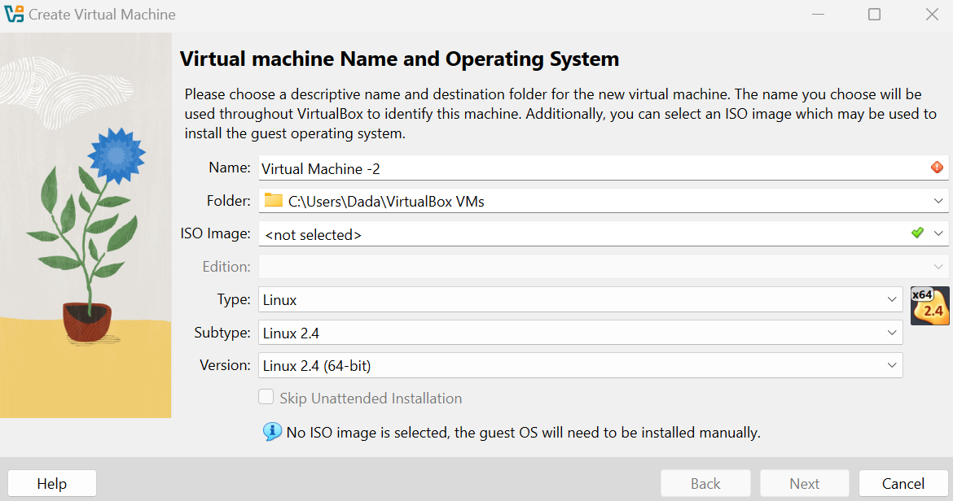
4.4 Configuring Virtual Machine – VM2 and VM3
Deploying 2 another Virtual Machines – 2 and 3 using VirtualBox.
Using same Ubuntu 24.04.1 LTS ISO image file for all three VMs for deploying OS.
Configure RAM (4GB or more), Storage (25GB or more), and Ubuntu (64-bit) settings.
All three VMs will appear in Oracle VirtualBox Manager.
All three will be in Power Off mode and we need to click start individually for the deployment of virtual machines with Ubuntu OS.
Explained in later slides

Slide 12

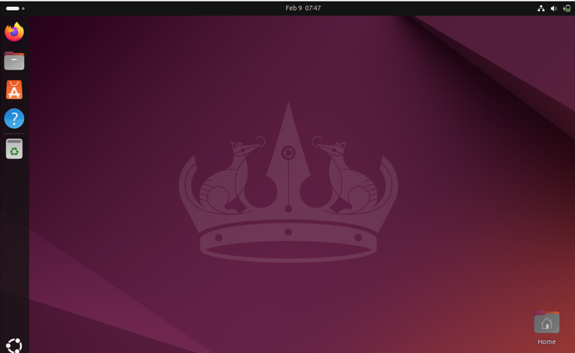
5. Starting Deployment of Virtual Machines with Ubuntu OS
Power On VM – Boot process starts.
GRUB Loads – Ubuntu kernel initializes.
System Services Start – Essential processes run.
Login Screen Appears – GUI or terminal ready.
Pre-installed Apps Available – Default Ubuntu tools ready.
Network Detected – Interface activation begins.
IP Assigned – DHCP (dynamic) or static IP applied.
Internet Access Checked – Connection established if enabled.
User Verifies Connectivity – ping or curl test.
System Ready – Fully operational.
Note: Same steps will be followed for all three VMs

Slide 13
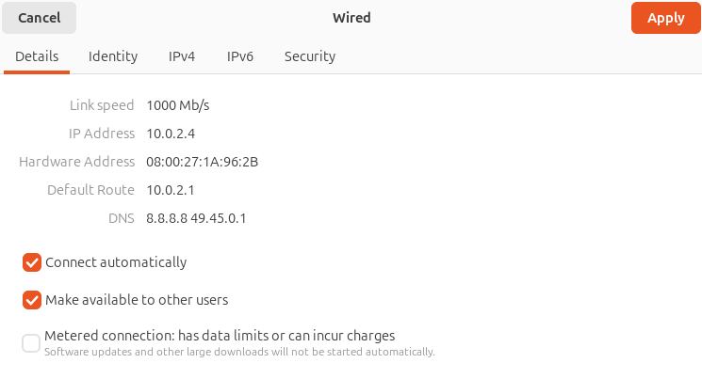
6. Internal connectivity of VMs through static IPv4

Slide 14
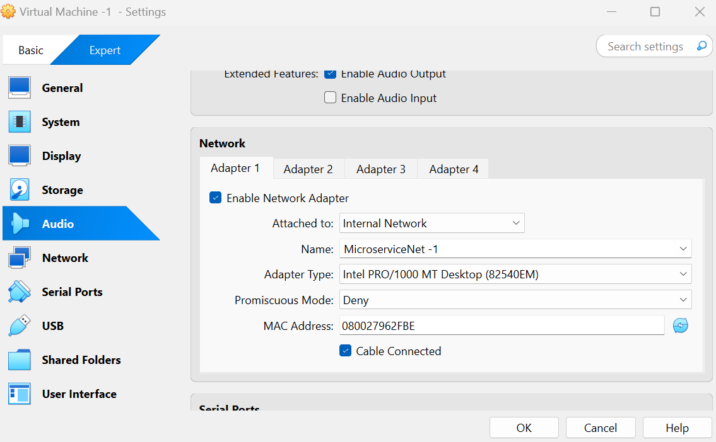

Slide 15
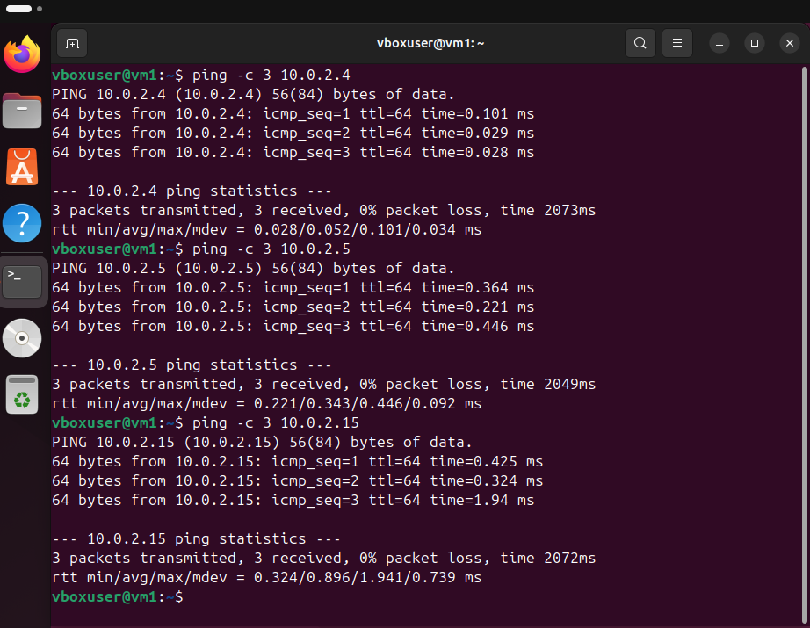
6.1 Ping Results – VM1(Self) → VM2 and VM3
The screenshot shows successful ping tests from VM-1 (10.0.2.4) to three other VMs:
Ping to 10.0.2.4 (itself) – Successful, indicating the network interface is active.
Ping to 10.0.2.5 – Successful, confirming connectivity to VM-2.
Ping to 10.0.2.15 – Successful, confirming connectivity to VM-3.
All VMs are reachable, and the internal network is properly configured with no packet loss.
Latency values are low, showing a healthy local network setup.

Slide 16
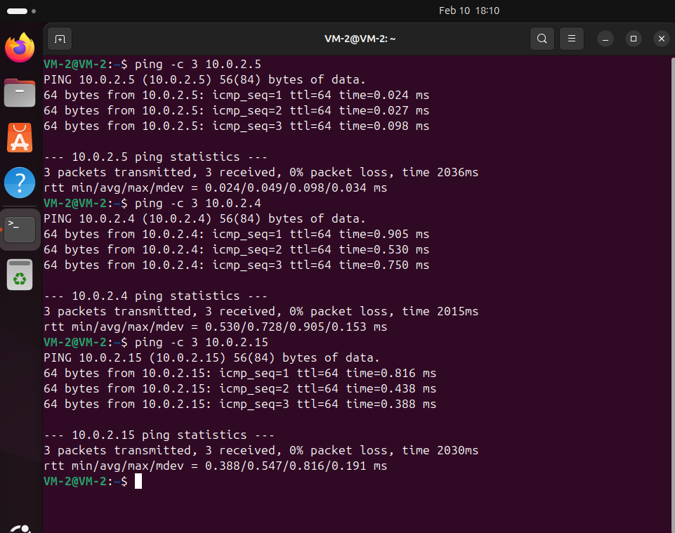
6.2 Ping Results – VM2(Self) → VM1 and VM3
The screenshot shows successful ping tests from VM-2 (10.0.2.5) to three other VMs:
Ping to 10.0.2.5 (itself) – Successful, indicating the network interface is active.
Ping to 10.0.2.4 – Successful, confirming connectivity to VM-1.
Ping to 10.0.2.15 – Successful, confirming connectivity to VM-3.
All VMs are reachable, and the internal network is properly configured with no packet loss.
Latency values are low, showing a healthy local network setup.

Slide 17
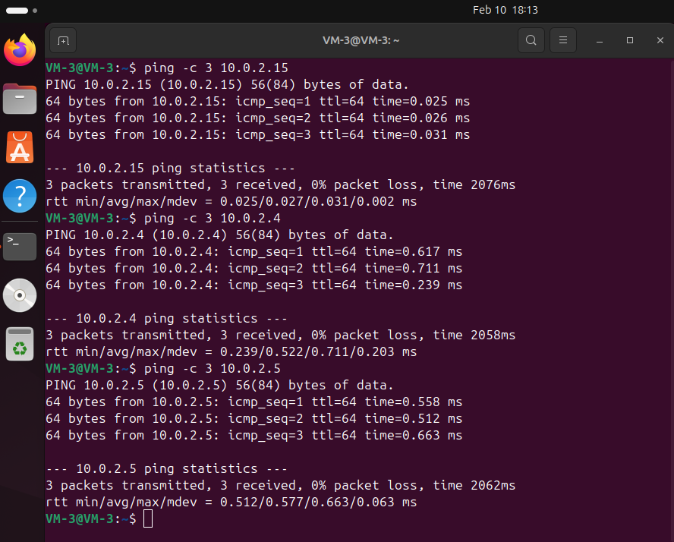
6.3 Ping Results – VM3(Self) → VM1 and VM3
The screenshot shows successful ping tests from VM-3 (10.0.2.15) to three other VMs:
Ping to 10.0.2.15 (itself) – Successful, indicating the network interface is active.
Ping to 10.0.2.4 – Successful, confirming connectivity to VM-1.
Ping to 10.0.2.5 – Successful, confirming connectivity to VM-2.
All VMs are reachable, and the internal network is properly configured with no packet loss.
Latency values are low, showing a healthy local network setup.

Slide 18
7. Flask-Based Microservice Deployment Across Three VMs
To test the connectivity and functionality of three VMs using a simple microservice,
We will deploy a simple Flask-based microservice across three interconnected Ubuntu VMs:
VM-1 (10.0.2.4) → API Gateway (Main service that aggregates responses from worker VMs)
VM-2 (10.0.2.5) → Worker Node 1 (Provides a data processing service)
VM-3 (10.0.2.15) → Worker Node 2 (Provides a log management service)
Note: After installing three VMs, my laptop became extremely slow and started hanging continuously. Due to this, I decided to install a small RESTful APIs based microservice that fulfills the objective of my assignment while also enabling me to understand this topic effectively.

Slide 19
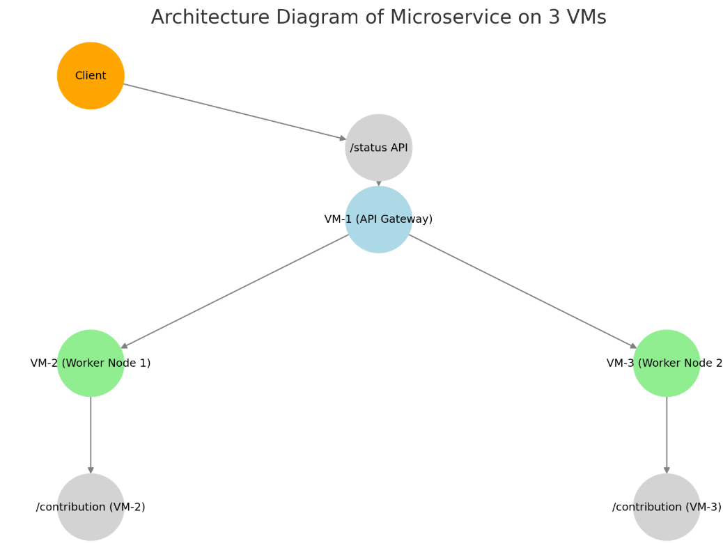
7.1 Architecture Diagram of Microservice on 3 VMs
Client sends a request to the API Gateway (VM-1) via the /status API.
VM-1 (API Gateway) forwards requests to the worker nodes.
VM-2 (Worker Node 1) handles data processing and responds via /contribution.
VM-3 (Worker Node 2) manages log management and responds via /contribution.
VM-1 collects responses from VM-2 and VM-3, aggregates them, and returns the combined response to the client.
This setup ensures modularity, fault tolerance, and scalability.

Slide 20
7.2 API Gateway (VM-1 - 10.0.2.4)
The API Gateway is the central point that:
Collects responses from Worker Node 1 (VM-2) and Worker Node 2 (VM-3).
Aggregates the responses and returns a combined result to the client.
Handles failures (e.g., if a worker node is down, it still returns partial results).
Example Workflow for API Gateway
A user sends a request to VM-1 (10.0.2.4) on port 5000.
The gateway fetches data from:
VM-2 (10.0.2.5:5001) → Data Processing Service
VM-3 (10.0.2.15:5002) → Log Management Service
It combines the responses and sends back a unified response.

Slide 21
7.3 API Gateway (VM-1 - 10.0.2.4) – Cont.
Example Request:
curl http://10.0.2.4:5000/status
Example Response:
{
"Main VM": "VM-1",
"Worker Contributions": [
{
"VM": "VM-2",
"Contribution": "Processing Sensor Data"
},
{
"VM": "VM-3",
"Contribution": "Managing System Logs"
}
]
}

Slide 22
7.4 Worker Node 1 (VM-2 - 10.0.2.5)
This node acts as a data processor:
It performs data analysis (e.g., sensor data processing, real-time calculations).
It exposes an API endpoint (/contribution) to return its status.
Example Request to Worker Node 1:
curl http://10.0.2.5:5001/contribution
Example Response:
{ "VM": "VM-2", "Contribution": "Processing Sensor Data" }
This response is collected by the API Gateway and included in the final output.

Slide 23
7.5 Worker Node 2 (VM-3 - 10.0.2.15)
This node acts as a log manager:
It handles logging (e.g., system logs, debugging, monitoring).
It exposes an (/contribution) to return its status.
Example Request to Worker Node 2:
curl http://10.0.2.15:5002/contribution
Example Response:
{ "VM": "VM-3", "Contribution": "Managing System Logs" }
Like Worker Node 1, this response is sent to the API Gateway for aggregation.

Slide 24
8. How They Work Together
Scenario 1: Everything Works:
A request to VM-1 (10.0.2.4:5000/status) will return contributions from both workers.
Scenario 2: VM-2 (Worker Node 1) Fails:
The API Gateway will detect failure and return:
{
"Main VM": "VM-1",
"Worker Contributions":
[
{
"VM": "VM-2",
"Contribution": "Error connecting"
},
{
"VM": "VM-3",
"Contribution": "Managing System Logs“
}
]
}
This setup ensures fault tolerance and scalability in a distributed microservice system

Slide 25
9. Step-by-Step Implementation – 1/6
Step : 1 Install Flask on All VMs
sudo apt update && sudo apt install python3-pip –y
pip3 install flask requests
Step : 2 Deploy Microservice on VM-2 (10.0.2.5)
On VM-2, create the file worker_vm2.py:
nano worker_vm2.py
from flask import Flask, jsonify
app = Flask(__name__)
@app.route('/contribution', methods=['GET'])
def contribution():
return jsonify({"VM": "VM-2", "Contribution": "Data Processing"})
if __name__ == '__main__':
app.run(host='0.0.0.0', port=5001)
Save and exit (CTRL+X, then Y, then Enter).

Slide 26
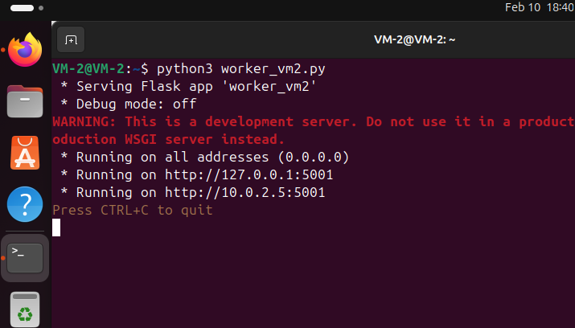
9.1 Step-by-Step Implementation – 2/6
Step 3: Run the Microservice by executing the following command:
python3 worker_vm2.py
This starts the Flask server on port 5001,
making it accessible inside the internal netwok.
Step 4: Test the Microservice
From VM-1 or VM-3, test the microservice using:
curl http://10.0.2.5:5001/contribution
{"VM": "VM-2", "Contribution": "Data Processing"}

Slide 27
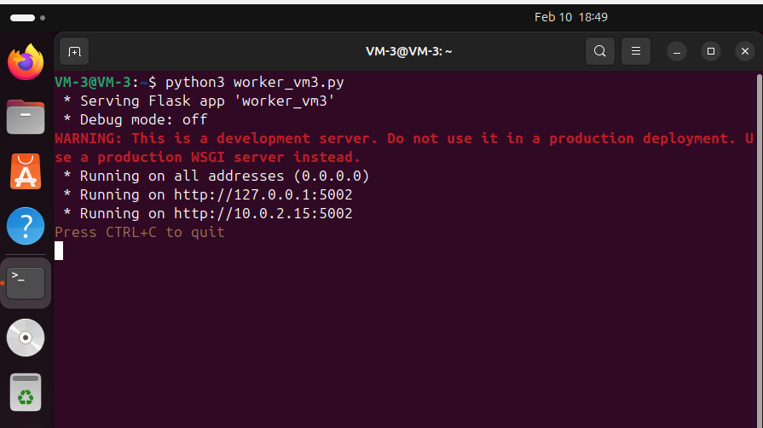
9.2 Step-by-Step Implementation – 3/6
Step 5: Create the Microservice File
On VM-3, create the file worker_vm3.py:
nano worker_vm3.py
from flask import Flask, jsonify
app = Flask(__name__)
@app.route('/contribution', methods=['GET'])
def contribution():
return jsonify({"VM": "VM-3", "Contribution": "Log Management"})
if __name__ == '__main__':
app.run(host='0.0.0.0', port=5002)
Save and exit (CTRL+X, then Y, then Enter).
Execute the following command to start the service:
python3 worker_vm3.py

Slide 28
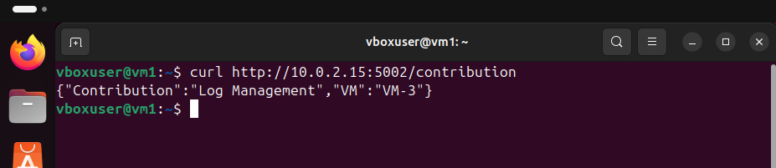
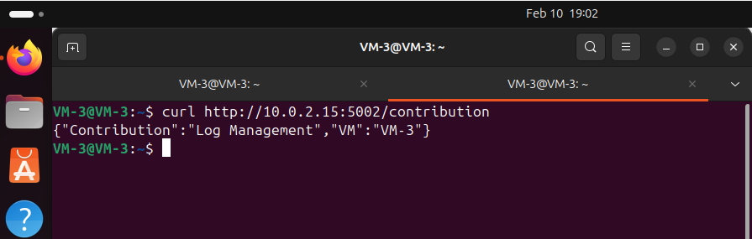
9.3 Step-by-Step Implementation – 4/6
Step 6: Test the Microservice
From VM-1 or VM-2, run:
curl http://10.0.2.15:5002/contribution
{"VM": "VM-3", "Contribution": "Log Management"}

Slide 29
9.4 Step-by-Step Implementation – 5/6
Step 7: Deploy API Gateway on VM-1 (Aggregator)
File: main_api_gateway.py
from flask import Flask, jsonify
import requests
app = Flask(__name__)
WORKER_NODES = {
"VM-2": "http://10.0.2.5:5001/contribution",
"VM-3": "http://10.0.2.15:5002/contribution"
}
@app.route('/status', methods=['GET'])
def status():
contributions = []
for vm, url in WORKER_NODES.items():
try:
response = requests.get(url, timeout=2)
if response.status_code == 200:
contributions.append(response.json())

Slide 30
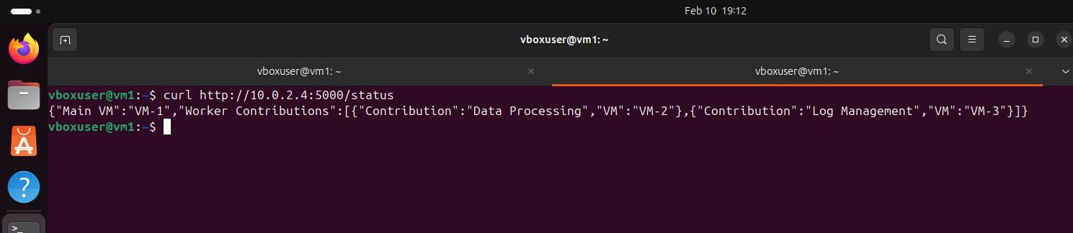
9.5 Step-by-Step Implementation – 6/6
else:
contributions.append({"VM": vm, "Contribution": "Unavailable"})
except requests.exceptions.RequestException:
contributions.append({"VM": vm, "Contribution": "Error connecting"})
return jsonify({"Main VM": "VM-1", "Worker Contributions": contributions})
if __name__ == '__main__':
app.run(host='0.0.0.0', port=5000)
Run: python3 main_api_gateway.py

